Slide 1
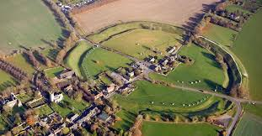
Avebury
Avebury has the biggest stones in the country as big as 31m by Dylan and Rafe

Slide 2
Stones arrival
The stones got there by cave people forking the stones on to logs and then rolling the stones over there. Cave people on one side levered their spears up and the Cave people on the other side had ropes and heaved them up.

Slide 3
The Stones
The stones look like 7m but they are actually 31m.

Slide 4
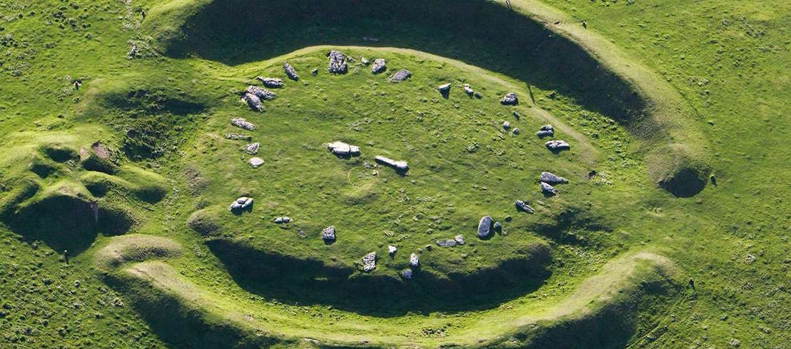
Facts
A Henge is a ditch around a hill.

